Slide 2
Status Report BCI: SSVEP
Group 31• 15.02.18
Prashanth H C
Pavan Kumar D
Sawan Singh Mahara
Lakshmiraj
Mrs. Vidya T V
Assistant Professor, PESIT-BSC

Slide 3
Brief Overview

Slide 4
Summary
SSVEP
Riemannian geometry
Recent progress
Dataset handling and extraction
Github https://github.com/SmellingSalt/Group31
Crude classification
Future Endeavours
Outlier removal
LED Array
Online Classification
Performance evaluation

Slide 5
Algorithmic Briefing

Slide 6
Training
Digital
EEG Database
EEG Extraction
Data Matrix
Covariance Matrix
Centroid Computation
Training Achieved

Slide 7
Testing
New
EEG Database
Epoch Extraction
Data Matrix
Covariance Matrix
Minimum distance to centroid cluster
Predicted Class

Slide 8
The Data

Slide 9
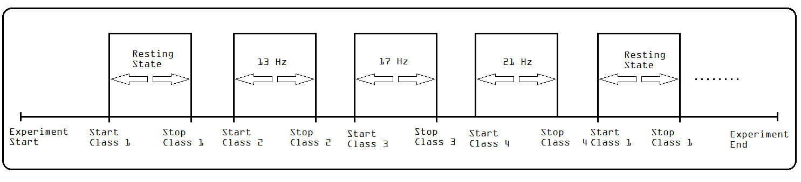
Data Recording Format

Slide 10
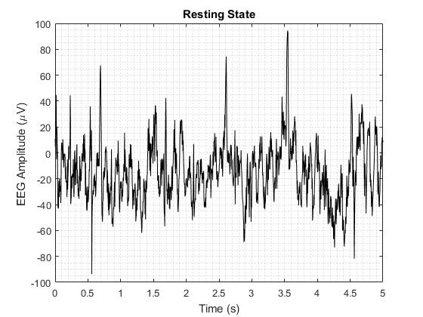
Normal EEG

Slide 11
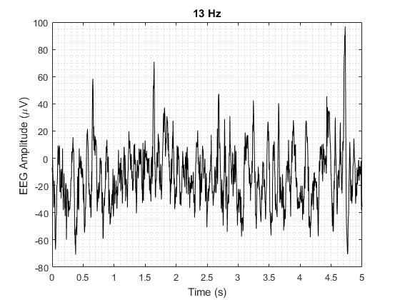
EEG in SSVEP

Slide 12
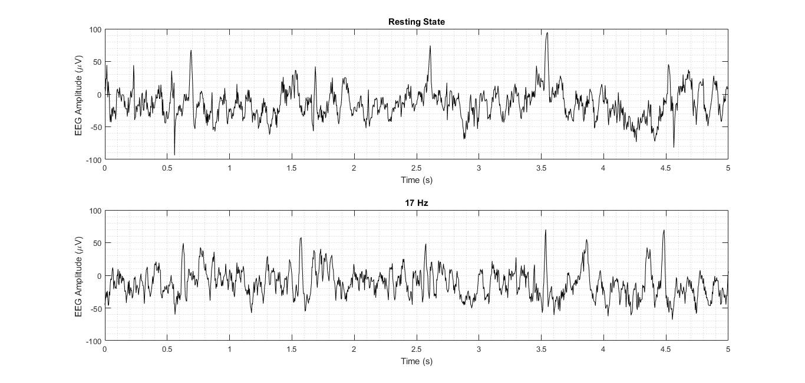

Slide 13
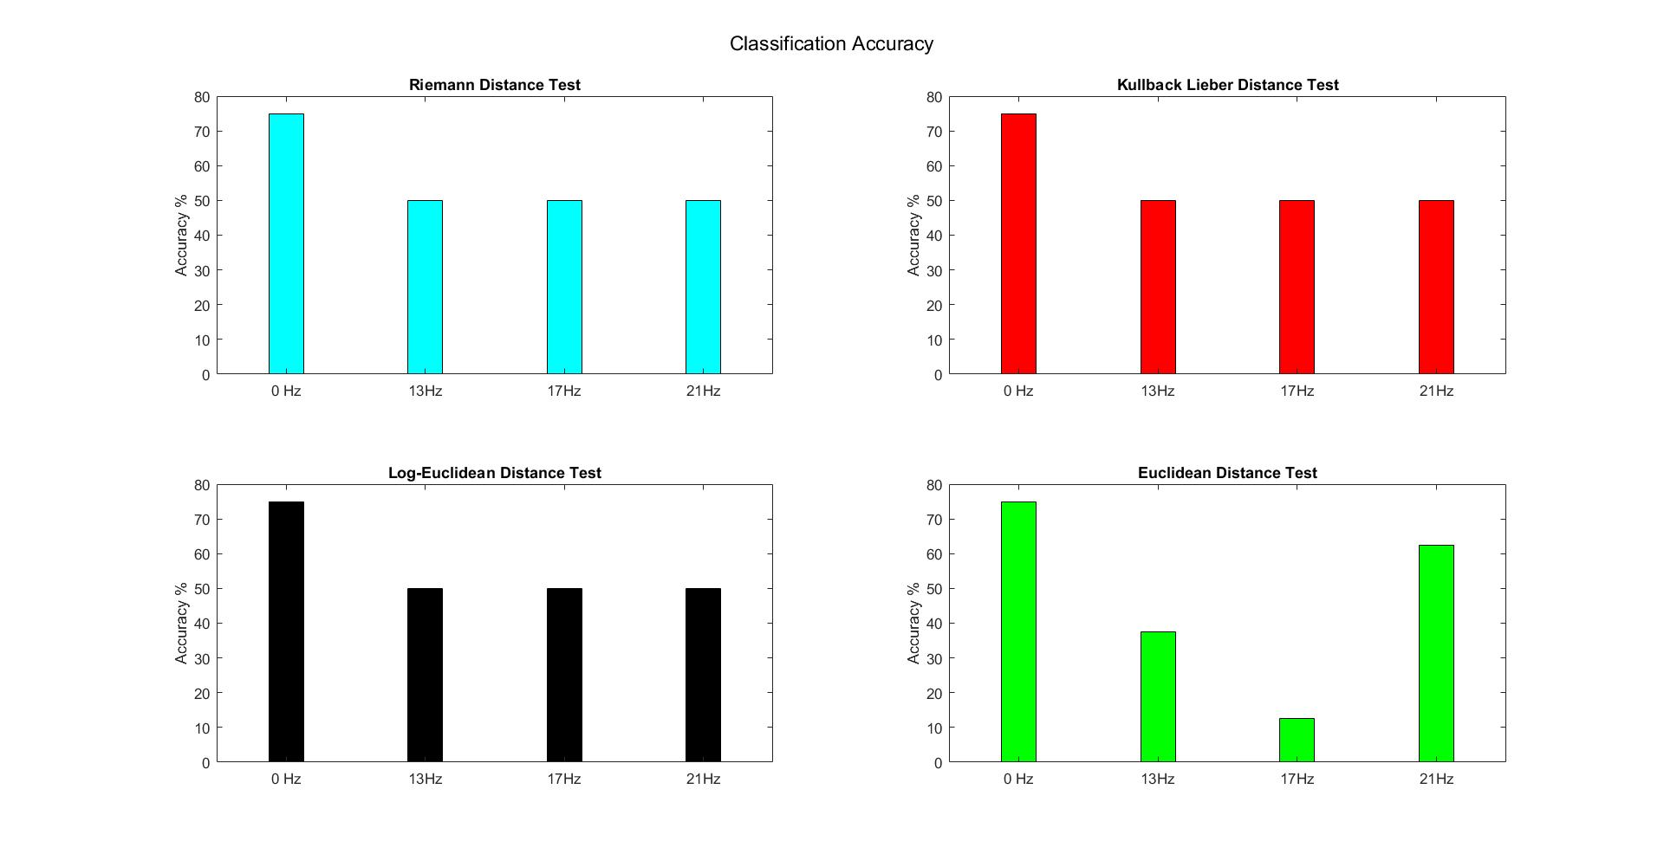
Results

Slide 14
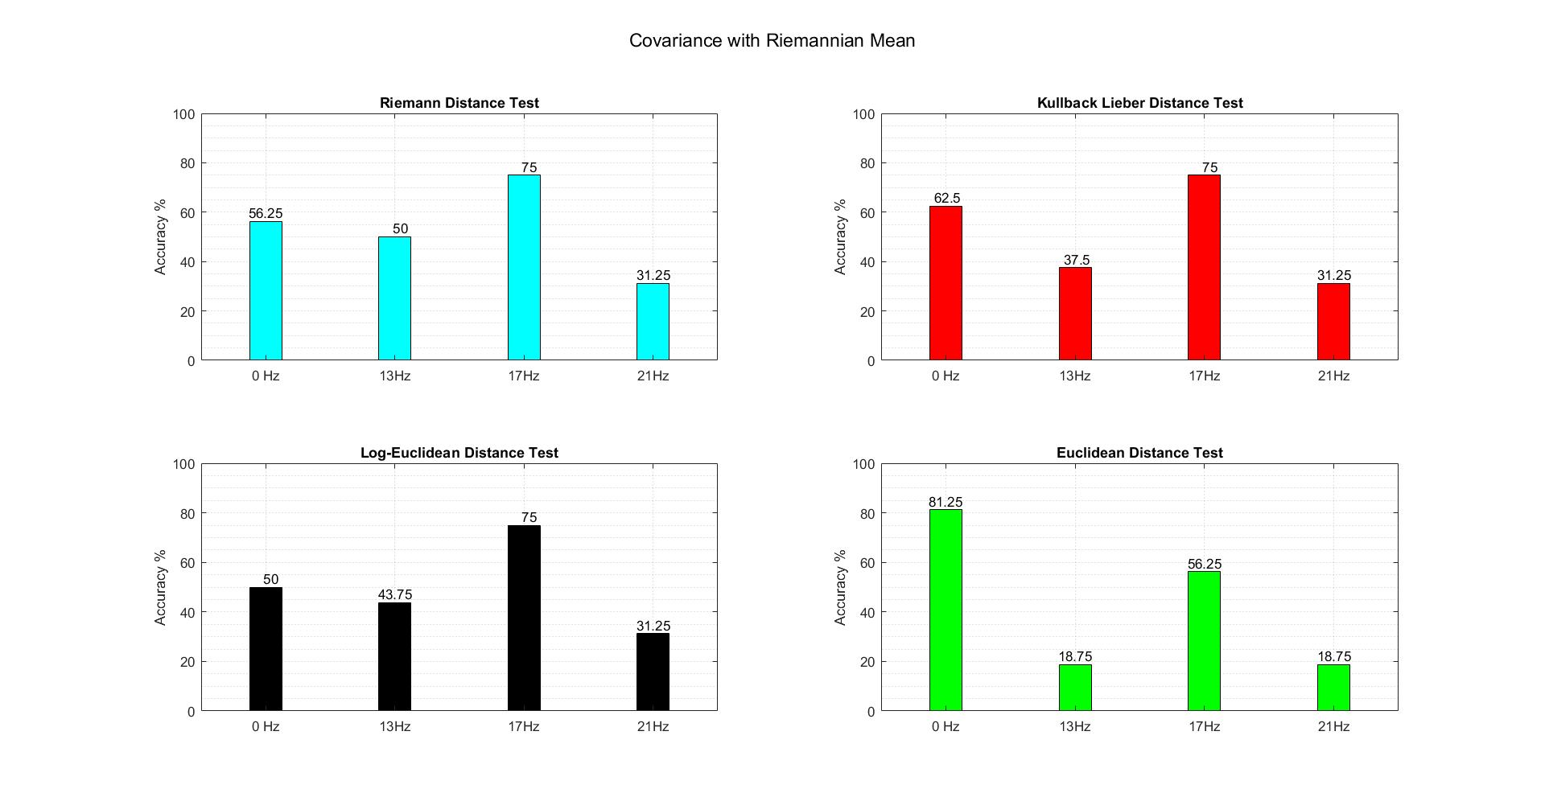
Results

Slide 15
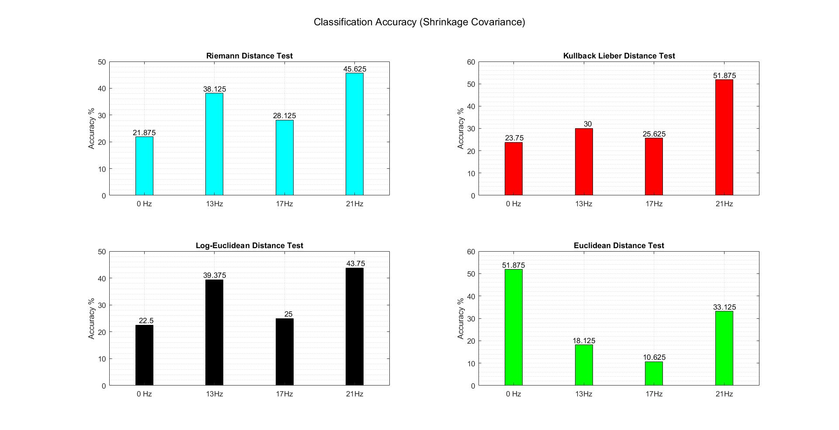
Results

Slide 16
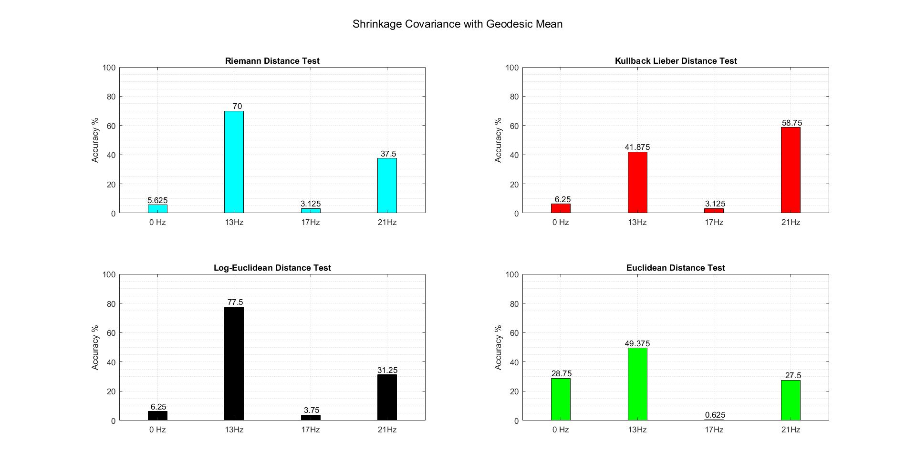
Results

Slide 17
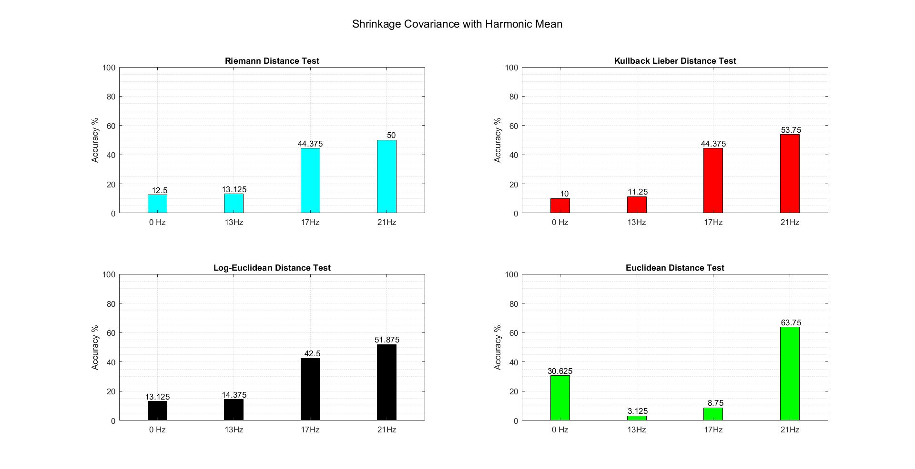
Results

Slide 18
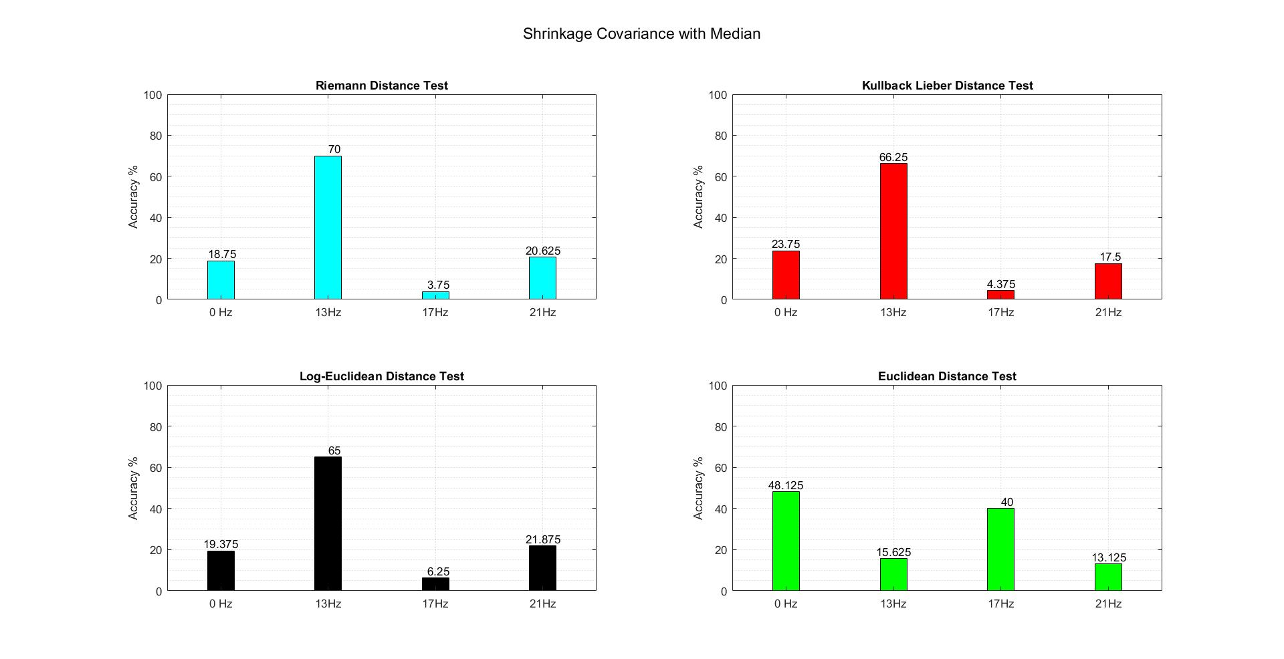
Results

Slide 19
Progress so Far
Accomplishments
Extraction of EEG segments
Data organisation
Covariance matrix formation from extracted segments
Crude Classification

Slide 20
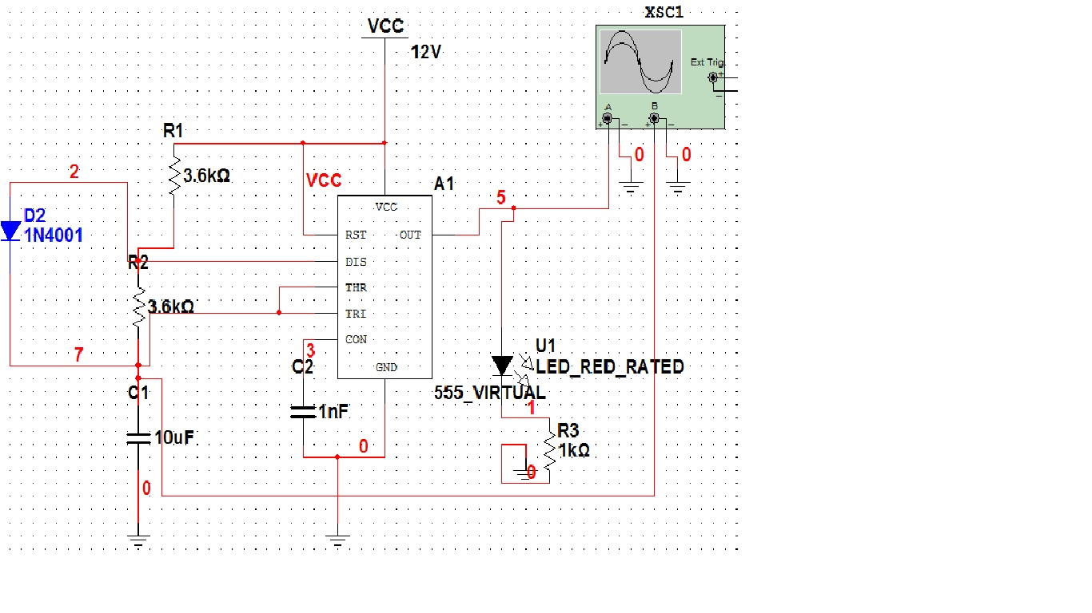
Led Array Schematic

Slide 21
Schedule

Slide 22
Implementation of core classification and optimisation
Optimisation and performance report
Algorithmic Study
November
January
February
March
April
Collection of Datasets and understanding how to use it.
Online implementation and own dataset creation using LED array

Slide 23
Next steps
Assignment 1
Optimisation of Classification by outlier removal, EEG pre-processing.
Assignment 2
LED array module and Recording of own EEG dataset
Assignment 3
Online Extraction and its optimisation

Slide 24
Goals for next meeting
Outlier removal and Optimized Offline Classifier
LED array Prototype

Slide 25
Thank You

